Slide 1
JESSICA MCPHAUL
GIS - Week 3 Edinburgh Revisited - Exercise 3-1:
Analyzing Neighborhood Closure vs Activity in Edinburgh
Assignment 3-1: Analyze neighborhood closures compared to neighborhood activity.
Use data from the City of Edinburgh open data portal.
Add and symbolize map layers
•Neighborhoods
•Shops
•Tram line
MAP 3. As demonstrated in class show map of restaurants in Edinburgh filtered from attribute table.
MAP 3a. map of the City of Edinburgh with all shops shown, and all shops which are vacant highlighted.
Look on the attribute table for ‘shops’ and write a SQL selection for 'vacant' shops.
MAP 3b. map of the City of Edinburgh showing only vacant shops, overlapped onto a choropleth map of the neighborhoods colored according to density (participating neighbors, normalized by area).
Add the Tram.
Q1. Describe how you see the vacant shop data in relationship to the neighborhood activity density data.
Q2. Is there any part of the city that seems to be particularly affected by closures/ vacancy?
Q3. Does the line of the tram seem to assist shops in staying open, or is it irrelevant to this data?

Slide 2
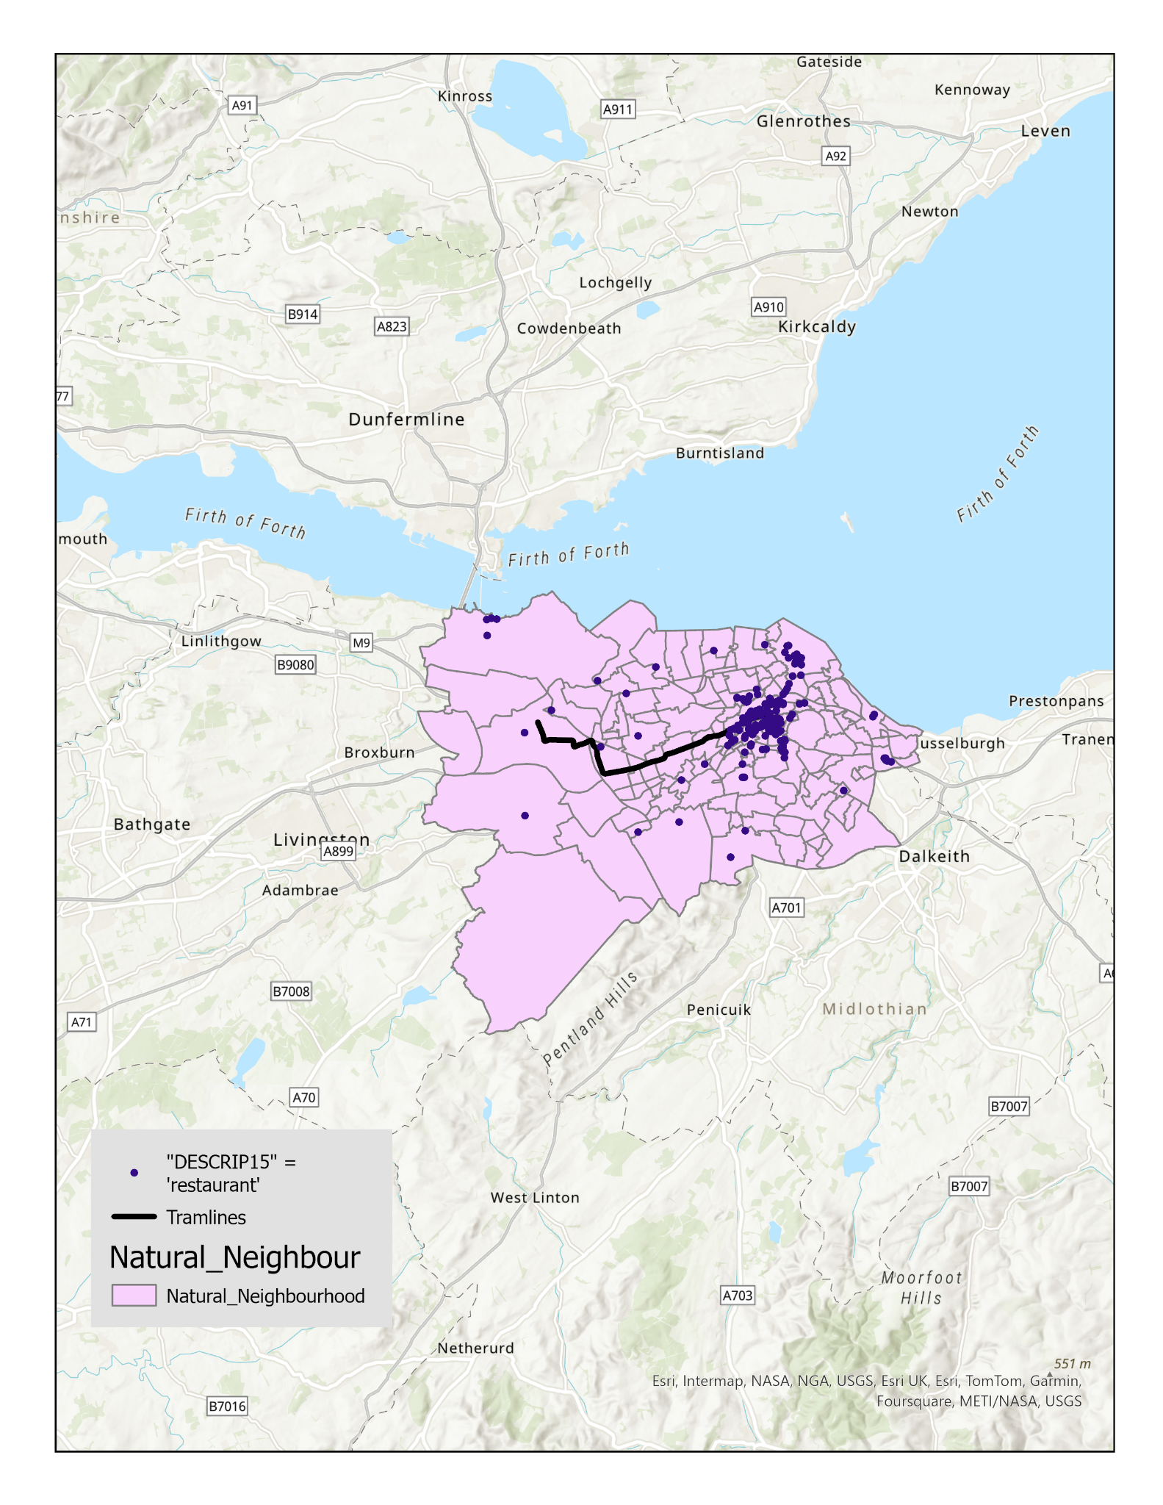
Map 3: Restaurants in Edinburgh
This map shows all restaurants across Edinburgh based on data from the Shop Survey

Slide 3
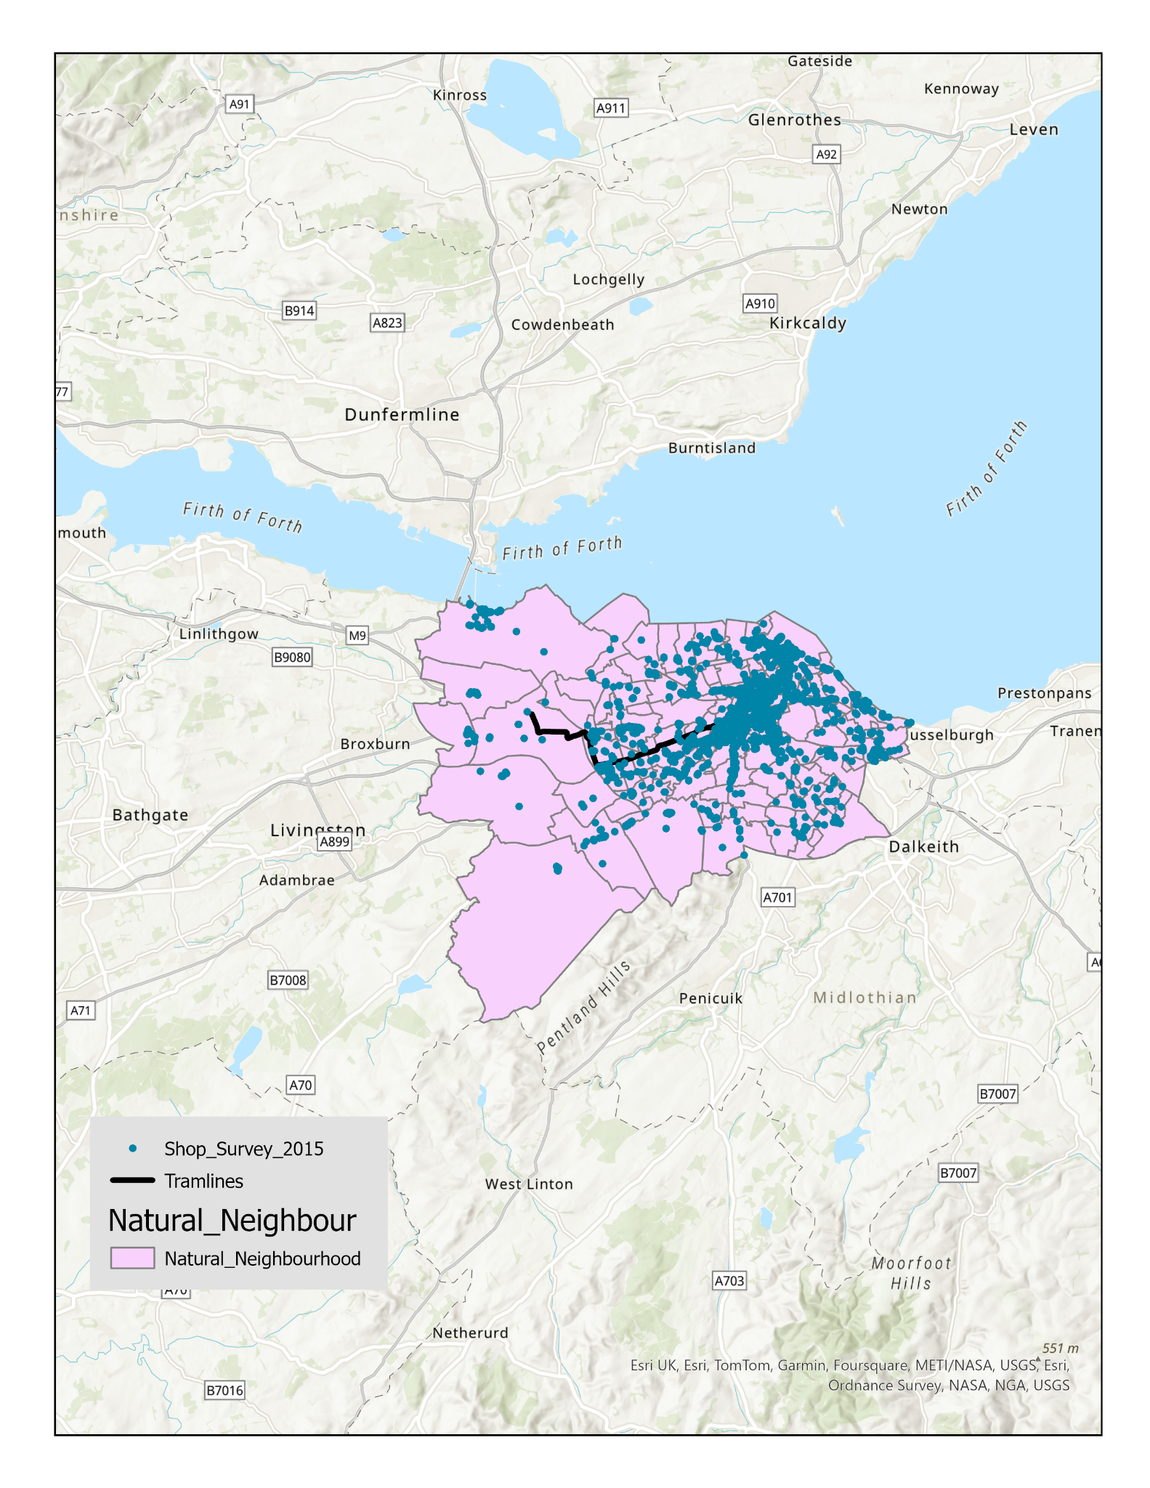
Map 3a: Neighborhoods, Shops and Tramlines
This map shows all shops and tramlines overlaid on Edinburgh neighborhoods.

Slide 4
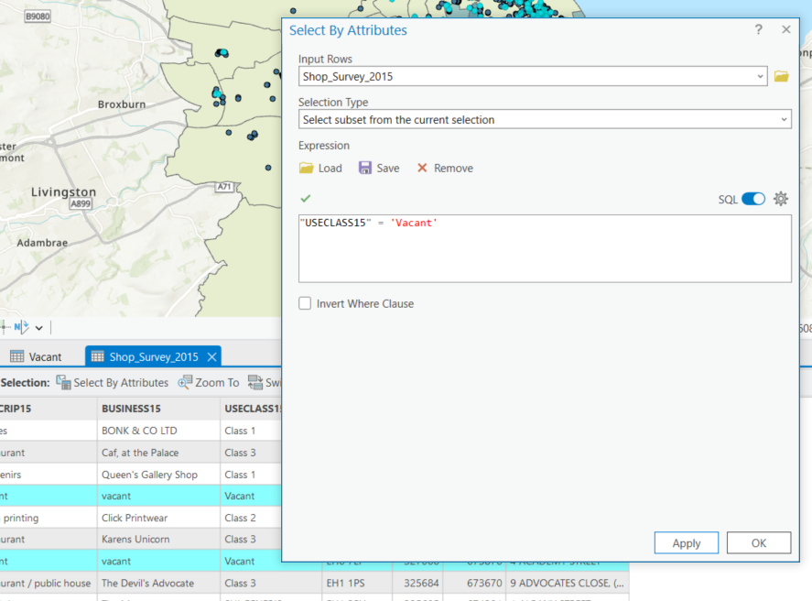
Map 3a2: SQL Query for Vacant Shops
The SQL selection used to identify vacant shops in Edinburgh from the dataset.

Slide 5
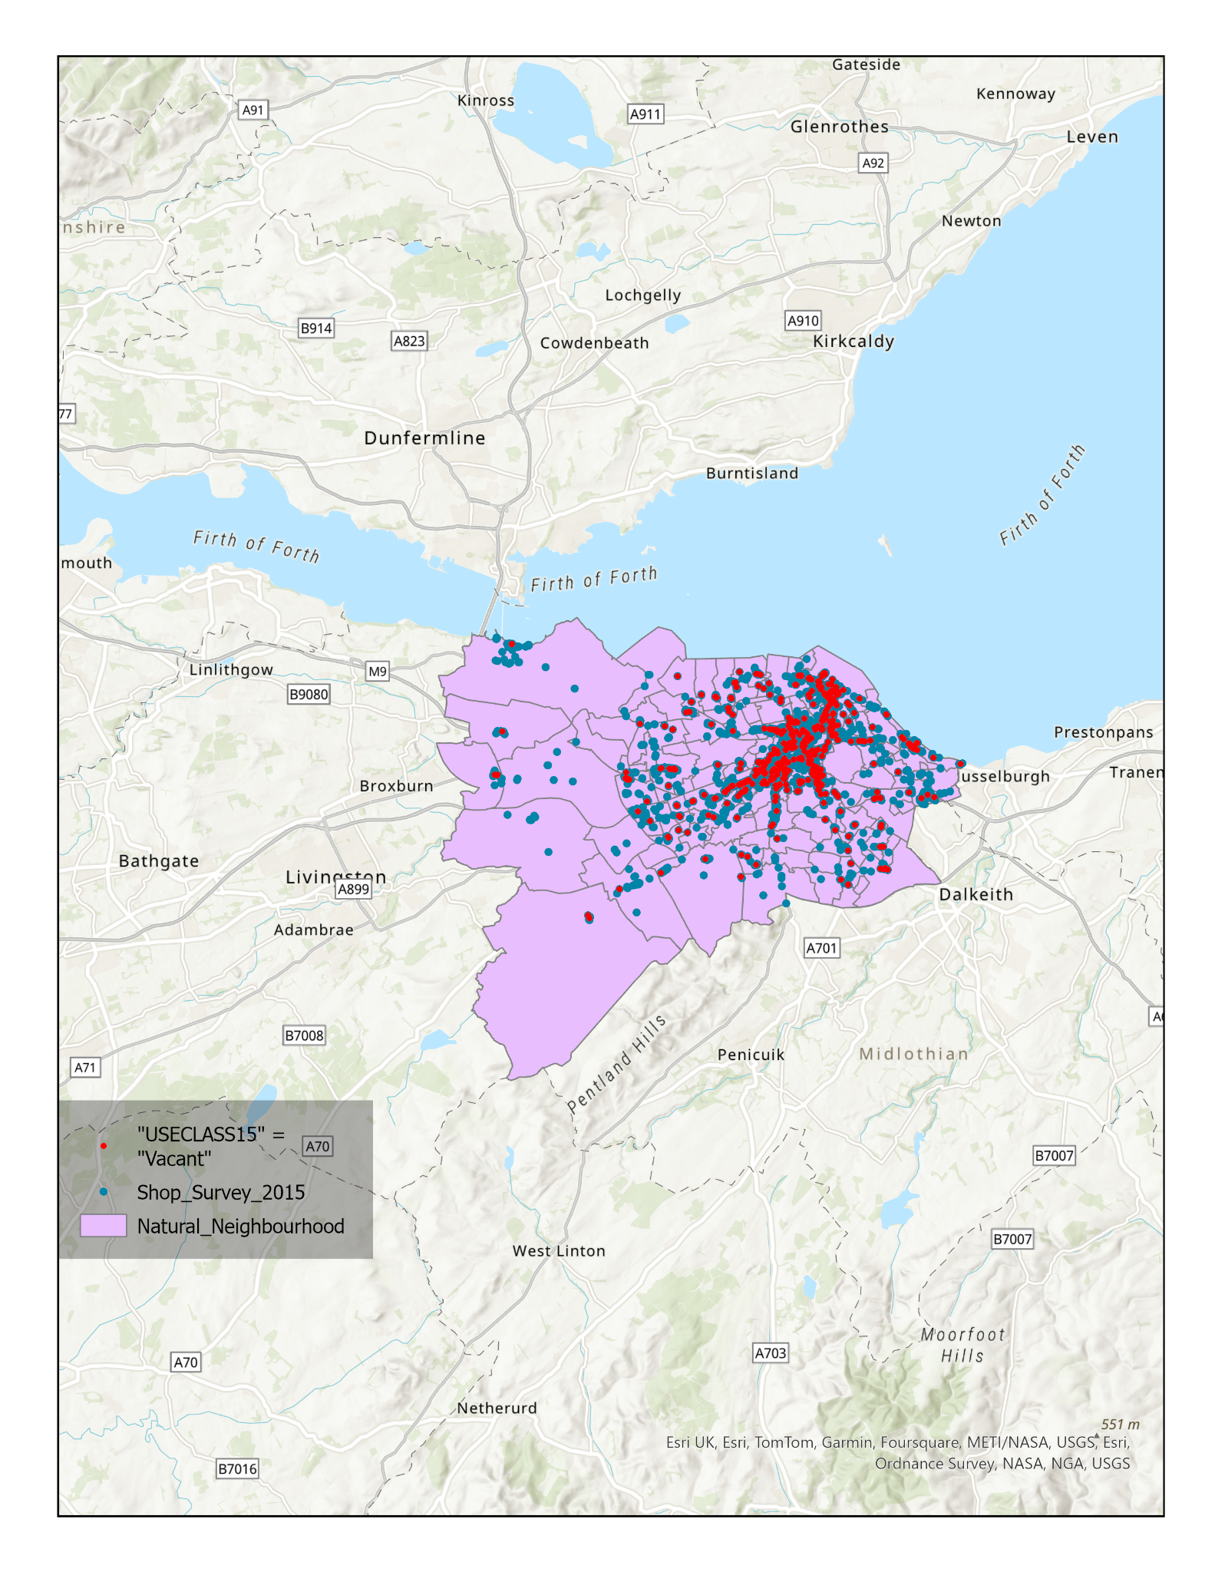
Map 3a3: All Shops with Vacant Shops Highlighted
This map shows all Edinburgh shops with vacant shops highlighted in red.

Slide 6
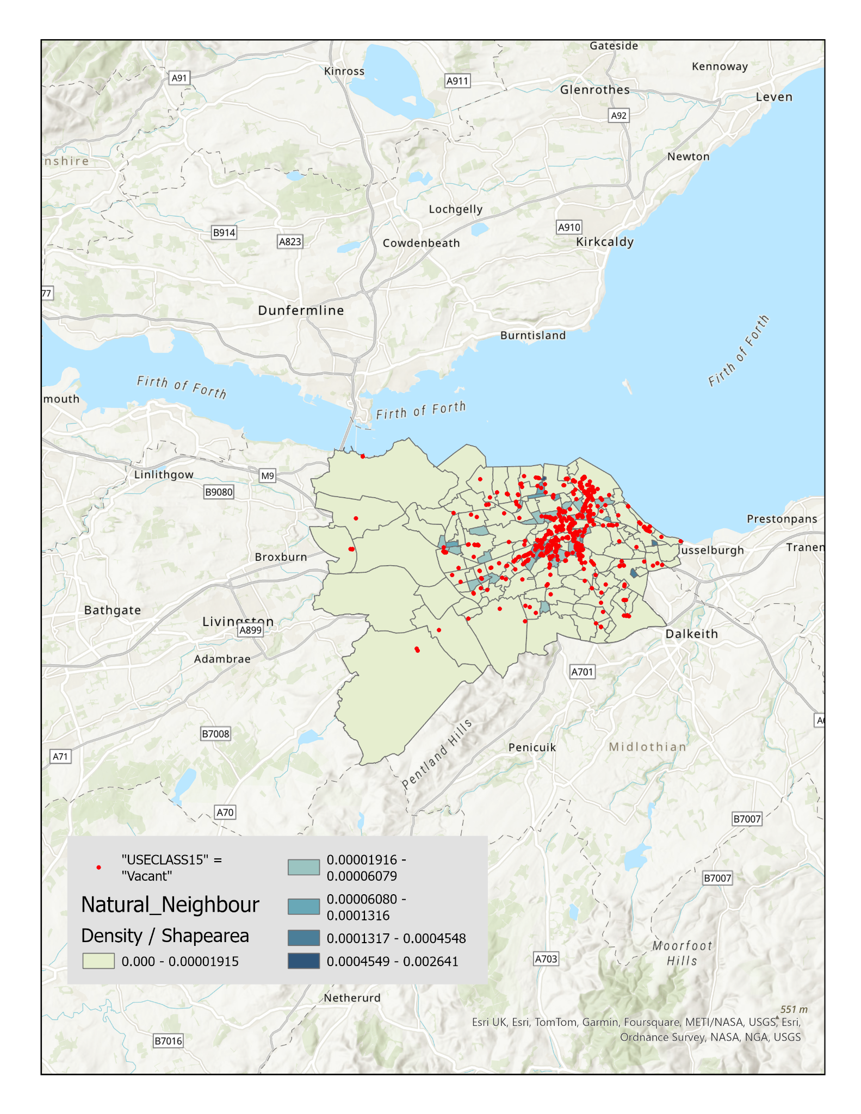
Map 3b: Vacant Shops on Choropleth Map (Density by Area)
Vacant shops are shown overlaid on a choropleth map of neighborhood density, normalized by area.

Slide 7

Map 3b2: Vacant Shops with Tramline Overlay
This map adds tramlines to show their relationship to vacant shop locations.

Slide 8
Questions
Q1. Describe how you see the vacant shop data in relation to neighborhood activity density data.
Answer: Vacant shops appear more concentrated in areas with lower neighborhood activity density. Higher density areas tend to have fewer vacant shops, indicating a possible correlation between active neighborhoods and shop occupancy.
Q2. Is there any part of the city particularly affected by closures/vacancy?
Answer: Yes, certain areas, especially those with lower activity density (as shown in the choropleth map), show a higher concentration of vacant shops. You might see this in less densely populated or suburban neighborhoods.
Q3. Does the tram line assist shops in staying open, or is it irrelevant?
Answer: The tram line seems to help. Shops closer to the tram line generally show fewer vacancies, suggesting that proximity to public transit may assist in keeping businesses open

